Slide 1

Decision-making
Decision-making constructs allow you to control the flow of your program based on certain conditions.
if Statement:
The if statement allows you to execute a block of code if a given condition is true.
if-else Statement: The if-else statement enables you to execute one block of code if a condition is true and another block if it's false.
if (condition)
{
// Code to execute if the condition is true
}
if (condition) {
// Code to execute if the condition is true
}
else
{
// Code to execute if the condition is false
}

Slide 2
Write C++ Program to Check Whether a Given Number is Even or Odd
/*
* C++ program to check if given integer is even or odd
*/
#include<iostream>
using namespace std;
int main()
{
int number;
cout << "Enter the number : ";
cin >> number;
if (number % 2 == 0)
cout << number << " is an even integer " << endl;
else
cout << number << " is an odd integer " << endl;
return 0;
}

Slide 3
Q) What will be output if you will compile and execute the following c++ code?
#include <iostream>
using namespace std;
int main() {
int a = 4;
if (a == 4) {
a = (a & 7);
cout << a;
} else {
a = a >> 2;
cout << a;
}
return 0;
}
4
2
8
1

Slide 4
Q) What will be output if you will compile and execute the following c++ code?
#include <iostream>
using namespace std;
int main() {
int a = 4;
if (a == 4) {
a = (a & 7);
cout << a;
} else {
a = a >> 2;
cout << a;
}
return 0;
}
4
2
8
1
0 1 0 0 ← 4
0 1 1 1 ← 7
---------
0 1 0 0 ←4
----------

Slide 5
Q) What will be output if you will compile and execute the following c++ code?
#include <iostream>
using namespace std;
int main() {
int i = 0, j = 0;
if (i++ == j++) {
cout << i-- << " " << j-- << " naveen";
} else {
cout << i << " " << j;
}
return 0;
}
The condition i++ == j++ compares values of i and j (both 0). The post-increment operators i++ and j++ first use the current values in the comparison and then increment the variables.
The comparison evaluates to true (1) since i and j are equal
The values of i and j (both 1 ) re printed using std::cout.
After printing, the post-decrement i-- and j-- are applied, decrementing i and j back to 0.
The string " naveen" is printed after the values of i and j.
Ans
1 1 naveen

Slide 6
Decision-making
if-else-if Ladder:
This construct is used when you have multiple conditions to check.
if (condition1) {
// Code for condition1
} else if (condition2)
{
// Code for condition2
} else if (condition3)
{
// Code for condition3
} else
{
// Code if none of the conditions are true
}

Slide 7
Q) What will be output if you will compile and execute the following c++ code?
#include <iostream>
using namespace std;
int main() {
int x=8,y=5;
if (x > 10) {
cout << "A";
}
else if (y < 7)
{
cout << "B";
}
else
{
cout << "C";
}
return 0;
}
a) A
b) B
c) C
d) AB

Slide 8
Q) What will be output if you will compile and execute the following c++ code?
#include <iostream>
using namespace std;
int main() {
int x=8,y=5;
if (x > 10) {
cout << "A";
}
else if (y < 7)
{
cout << "B";
}
else
{
cout << "C";
}
return 0;
}
a) A
b) B
c) C
d) AB

Slide 9
Q) Write a C++ program to check whether a character is an alphabet, digit or special character
OUTPUT
Sample Input
Enter a character A
Sample Output
This is an alphabet
LOGIC
1. Read a character char ch
2. If ch is in a to z or A to z then print it as alphabet
3. Otherwise if the ch is 0 to 9 then print it as digit
4. Otherwise print ch as special character

Slide 10
//C++ program to check whether a character is an alphabet, digit or special character
#include <iostream>
using namespace std;
int main() {
char ch;
cout << "Enter a character: ";
cin >> ch;
if ((ch >= 'a' && ch <= 'z') || (ch >= 'A' && ch <= 'Z’))
{
cout << "This is an alphabet" << endl;
} else if (ch >= '0' && ch <= '9’)
{
cout << "This is a digit" << endl;
} else
{
cout << "This is a special symbol" << endl;
}
return 0;
}
OUTPUT:
Enter a character
D
This is an alphabet
Enter a character
9
This is an digit

Slide 11
Q) Create C++ application for an ATM simulator. The charges are as follow.
OPERATIONS:
Checking balance
Making deposits
Withdrawing money
Output:
Welcome to the ATM Simulator!
1. Check Balance
2. Make a Deposit
3. Withdraw Money
4. Exit
Enter your choice: 2
Enter deposit amount: $500
Deposit successful. Your new balance: $1500

Slide 12
//ATM SIMULATOR APP
#include <iostream>
using namespace std;
int main() {
double balance = 1000.0; // Initial account balance
cout << "Welcome to the ATM Simulator!" << endl;
cout << "1. Check Balance" << endl;
cout << "2. Make a Deposit" << endl;
cout << "3. Withdraw Money" << endl;
cout << "4. Exit" << endl;
int choice;
cout << "Enter your choice: ";
cin >> choice;
if (choice == 1)
{
cout << "Your balance: $" << balance << endl;
} else if (choice == 2)
{
double depositAmount;
cout << "Enter deposit amount: $";
cin >> depositAmount;
balance += depositAmount;
cout << "Deposit successful. Your new balance: $" << balance << endl;
} else if (choice == 3)
{
double withdrawAmount;
cout << "Enter withdrawal amount: $";
cin >> withdrawAmount;
if (withdrawAmount > balance) {
cout << "Insufficient funds." << endl;
} else
{
balance -= withdrawAmount;
cout << "Withdrawal successful. Your new balance: $" << balance << endl;
}
} else if (choice == 4) {
cout << "Thank you for using the ATM. Goodbye!" << endl;
} else {
cout << "Invalid choice." << endl;
}
return 0;
}

Slide 13
Q) Create C++ application for an Electricity Bill Generator . The charges are as follow.
Unit | Charge Unit
50 | @7.0
<=150 and >50 | @9.0
<=250 and >150 | @12.0
>250 | @15.0
Sample Input:
Enter the units consumed 50
Sample Output:
Electricity Bill= 350.00
Sample Input:
Enter the units consumed -50
Sample Output:
Please enter valid consumed units…

Slide 14
#include <iostream>
using namespace std;
int main() {
float bill, units;
cout << "Enter the units consumed = ";
cin >> units;
if (units <= 50 && units >= 0) {
bill = units * 7.0;
cout << "Electricity Bill = " << bill << " Rupees" << endl;
} else if (units <= 150 && units > 50) {
bill = units * 9.0;
cout << "Electricity Bill = " << bill << " Rupees" << endl;
} else if (units <= 250 && units >= 150) {
bill = units * 12.0;
cout << "Electricity Bill = " << bill << " Rupees" << endl;
} else if (units > 250) {
bill = units * 15;
cout << "Electricity Bill = " << bill << " Rupees" << endl;
} else {
cout << "Please enter valid consumed units..." << endl;
}
return 0;
}

Slide 15
Q) CREATE A PASSWORD VALIDATOR APP For wrong password print "Incorrect password" and for correct password print "Correct password with his/her name" and quit the program. The correct password is 1234
OUTPUT
Sample Input
Enter your Name: xyz
Enter your password:1234
Sample Output
Welcome to chitkara Mr/Ms.xyz

Slide 16
PASSWORD VALIDATOR APP
#include <iostream>
using namespace std;
int main() {
int pass;
char name[20];
cout << "Input Your name: ";
cin >> name;
cout << "Input the password: ";
cin >> pass;
if (pass == 1234)
{
cout << "Welcome to Chitkara, Mr. " << name << endl;
} else {
cout << "Wrong password, try another" << endl;
}
return 0;
}

Slide 17
Nested if
Use one if or else if statement inside another if or else if statement(s).
Syntax:
if (condition1)
{
// code to be executed if condition1 is true
if (condition2)
{
// code to be executed if condition2 is true
}
}

Slide 18
Q) Write a C++ program that takes a person's age as input and determines whether they are an adult or a minor. If they are an adult, the program further checks if they are a senior citizen (age 60 or above) and provides corresponding output.
Enter your age: 25
You are an adult.
You are not a senior citizen.
LOGIC
The program stores the user's age as an integer.
After asking the user for their age, the program checks three cases:
a. If the age is 60 or more, the program prints "senior citizen."
b. If the age is between 18 and 59, the program prints "adult but not a senior citizen."
c. If the age is less than 18, the program prints "minor."
The program ends.

Slide 19
// determines whether they are an adult or a minor. AND senior citizen
#include <iostream>
int main() {
int age;
std::cout << "Enter your age: ";
std::cin >> age;
if (age >= 18) {
std::cout << "You are an adult." << std::endl;
if (age >= 60) {
std::cout << "You are a senior citizen." << std::endl;
} else {
std::cout << "You are not a senior citizen." << std::endl;
}
} else {
std::cout << "You are a minor." << std::endl;
}
return 0;
}

Slide 20
Decision-making
switch-case Statement:
The switch statement provides an efficient way to evaluate a variable against multiple possible values.
switch (variable) {
case value1:
// Code for value1
break;
case value2:
// Code for value2
break;
// ...
default:
// Code if none of the cases match
}

Slide 21
Switch Case (Multiple Branching Statement)
The switch statement allows us to execute one code block among many alternatives.
Allows us to execute multiple operations for the different possible values of a single variable called switch variable.
We can define various statements in the multiple cases for the different values of a single variable.
Syntax:
switch(expression){
case 1:
//code to be executed;
break;
case 2:
//code to be executed;
break;
......
default:
code to be executed if all cases are not matched;
}

Slide 22
Q) What will be output if you will compile and execute the following c++ code?
#include <iostream>
int main() {
int a = 2;
switch (a) {
case 2: std::cout << "0 "; break;
case 3: std::cout << "3 "; break;
case 5: std::cout << "5 "; break;
default: std::cout << "Go ";
}
switch (a) {
case 2: std::cout << "0 "; break;
case 3: std::cout << "3 "; break;
case 5: std::cout << "5 "; break;
default: std::cout << "Go "; break;
}
std::cout << "Done!";
return 0;
}
0 Go 0 Go Done!
0 Go 0 Done!
0 0 Done!
Done!

Slide 23
Q) What will be output if you will compile and execute the following c++ code?
#include <iostream>
int main() {
int a = 2;
switch (a) {
case 2: std::cout << "0 "; break;
case 3: std::cout << "3 "; break;
case 5: std::cout << "5 "; break;
default: std::cout << "Go ";
}
switch (a) {
case 2: std::cout << "0 "; break;
case 3: std::cout << "3 "; break;
case 5: std::cout << "5 "; break;
default: std::cout << "Go "; break;
}
std::cout << "Done!";
return 0;
}
0 Go 0 Go Done!
0 Go 0 Done!
0 0 Done!
Done!

Slide 24
Q) What will be output if you will compile and execute the following c++ code?
#include<iostream>
using namespace std;
int main()
{
int a;
switch(a)
{
cout << "DEER ";
}
cout << "LION";
return 0;
}

Slide 25
Nested switch case statement
A switch statement inside another switch statement.
Such type of statements is called nested switch case statements.
Syntax:
switch(expression1) {
case value1:
statements;
switch(expression2)
{
case value:
inner switch statements;
break; .
.
}
break;
case value2: /* case code */
}

Slide 26
Repetitive Constructs:
Repetitive constructs allow you to execute a block of code repeatedly based on certain conditions.
while
for
do - while

Slide 27
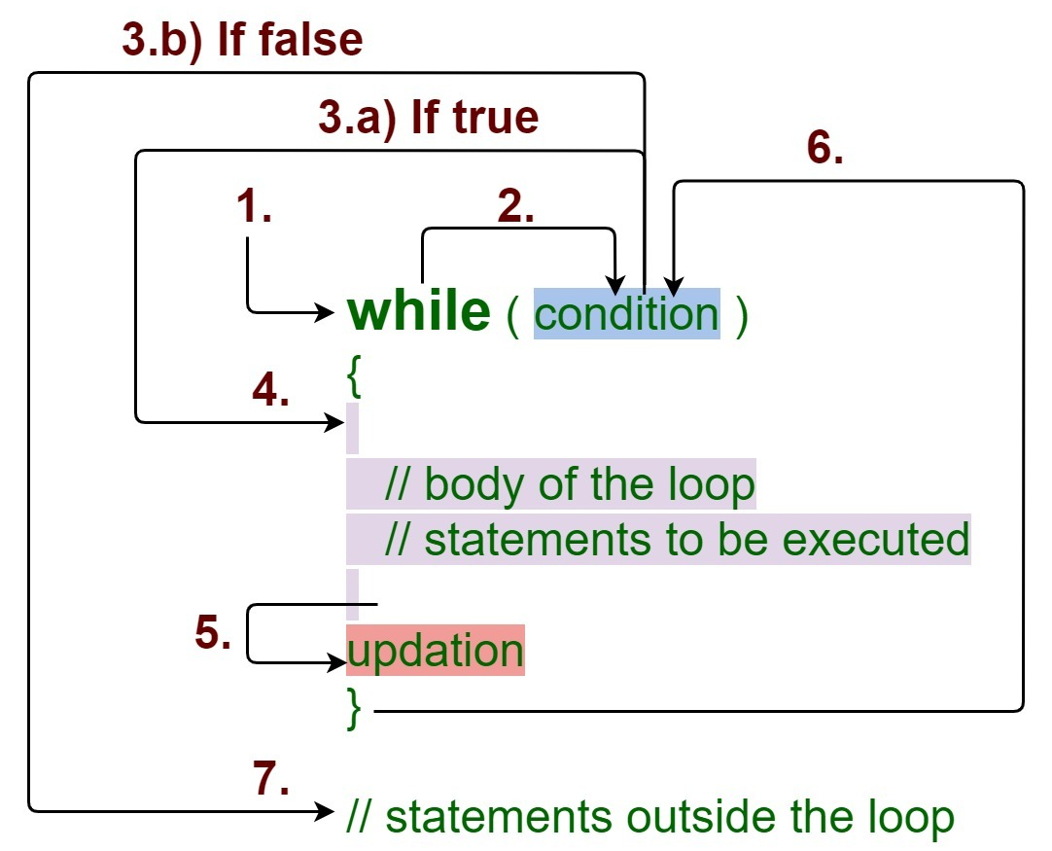
while Loop
The while loop loops through a block of code as long as a specified condition is true.
Syntax:
while (condition)
{
// code block to be executed
//increment or decrement
}

Slide 28
while Loop
int i=1;
while (i<=10)
{
cout<<“Hello”;
i++;
}
How while loop works?
While loop evaluates the testExpression(condition) inside the parentheses ().
If testExpression is true, statements inside the body of while loop are executed. then, testExpression is evaluated again.
The process goes on until testExpression is evaluated to false.
If testExpression is false, the loop terminates (ends).

Slide 29
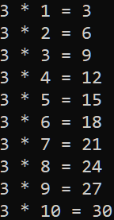
while Loop
Write a C++ program to read an integer and print its multiplication table
Logic:
Read an integer number
Take a loop counter and initialize it with 1
Run a loop from 1 to 10
Print the multiplication of input number and loop counter
Increase the loop counter

Slide 30
while Loop
Write a C++ program to find Sum of digits of a given number using while.
LOGIC
Step 1: Get number by user
Step 2: Ger remainder of the number
Step 3: Sum the remainder of the number
Step 4: Divide the number by 10
Step 5: Repeat the step 2 while number is greater than 0.
Example:
Enter a number:654
Sum is=15
Enter a number:123
Sum is=6

Slide 31
while Loop
#include <iostream>
int main() {
int n, sum = 0, rem;
std::cout << "Enter a number:";
std::cin >> n;
while (n != 0) {
rem = n % 10;
sum = sum + rem;
n = n / 10;
}
std::cout << "Sum is=" << sum;
return 0;
}

Slide 32
while Loop
Write a C++ Program to find the reverse of a given number
Example:
Enter a number: 123
Reversed Number: 321
LOGIC
Enter any n.
Declare rev=0, where rev an integer variable.
Get rem(last_digit) of n by performing the modulo division (%) and store the value in rem(last_digit) variable, likey rem= n % 10.
Multiply rev by 10 and add rem(last_digit), like rev = rev*10 + rem.
Divide n by 10, like n/10.
Repeat the steps 3 to 5 till numbered is not equal to (or greater than) zero.

Slide 33
while Loop
#include <iostream>
using namespace std;
int main() {
int n, reverse = 0, rem;
cout << "Enter a number: ";
cin >> n;
while (n != 0) {
rem = n % 10;
reverse = reverse * 10 + rem;
n /= 10;
}
cout << "Reversed Number: " << reverse;
return 0;
}

Slide 34
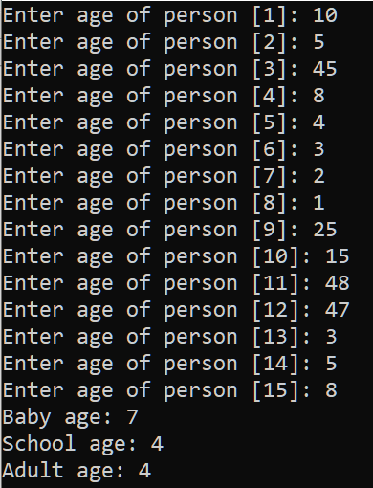
while Loop
Write a C program to read age of 15 persons and count total Baby age, School age and Adult age
Question
WAP to read an age of 15 person & find out how many of them fall under : a) Still a baby- age 0 to 5 b) Attending school - age 6 to 17 c) Adult life-age 18 & over [using while loop]

Slide 35
#include <stdio.h>
int main()
{
int age;
int cnt_baby=0,cnt_school=0,cnt_adult=0;
int count=0;
while(count<15)
{
printf("Enter age of person [%d]: ",count+1);
scanf("%d",&age);
if(age>=0 && age<=5)
cnt_baby++;
else if(age>=6 && age<=17)
cnt_school++;
else
cnt_adult++;
//increase counter
count++;
}
printf("Baby age: %d\n",cnt_baby);
printf("School age: %d\n",cnt_school);
printf("Adult age: %d\n",cnt_adult);
return 0;
}

Slide 36
Q) Create a C++ app for Rock-Paper-Scissors Game
The Rock-Paper-Scissors game is a simple hand game usually played between two people.
Each player simultaneously forms one of three shapes with their hand: rock, paper, or scissors.
The possible outcomes are:
Rock crushes scissors (Rock wins)
Scissors cuts paper (Scissors wins)
Paper covers rock (Paper wins)
If both players choose the same shape, it's a tie
Logic:
The program starts by welcoming the user to the game.
The user is presented with options to choose either Rock, Paper, Scissors, or to Quit the game.
The user's choice is compared against a random choice made by the computer.
The program then determines the winner based on the rules of the game.
The user is informed of the result, and the loop continues until the user decides to quit.
OUTPUT
Welcome to Rock-Paper-Scissors Game!
Choose your move:
1. Rock
2. Paper
3. Scissors
4. Quit
Enter your choice (1-4): 2
Computer's choice: Rock
You win!

Slide 37
#include <iostream>
#include <cstdlib>
#include <ctime>
using namespace std;
int main() {
srand(time(0)); // random number with the current time
cout << "Welcome to Rock-Paper-Scissors Game!" << endl;
while (true) {
cout << "Choose your move:" << endl;
cout << "1. Rock" << endl;
cout << "2. Paper" << endl;
cout << "3. Scissors" << endl;
cout << "4. Quit" << endl;
int userChoice;
cout << "Enter your choice (1-4): ";
cin >> userChoice;
if(userChoice == 4) {
cout << "Thanks for playing!" << endl;
break; }
if (userChoice < 1 || userChoice > 3) {
cout << "Invalid choice. Please select again." << endl;
continue;
}
int computerChoice = rand() % 3 + 1; // Generate random computer choice
cout << "Computer's choice: ";
switch (computerChoice) {
case 1:
cout << "Rock" << endl;
break;
case 2:
cout << "Paper" << endl;
break;
case 3:
cout << "Scissors" << endl;
break; }
if (userChoice == computerChoice) {
cout << "It's a tie!" << endl;
} else if ((userChoice == 1 && computerChoice == 3) ||
(userChoice == 2 && computerChoice == 1) ||
(userChoice == 3 && computerChoice == 2)) {
cout << "You win!" << endl;
} else {
cout << "Computer wins!" << endl; }
cout << endl; }
return 0;
}

Slide 38
for Loop
Syntax:
for (statement 1; statement 2; statement 3)
{
// code block to be executed;
}
Statement 1 is executed (one time) before the execution of the code block. It is an initialization statement.
Statement 2 defines the condition for executing the code block. It is a conditional statement.
Statement 3 is executed (every time) after the code block has been executed. It is a updating statement.

Slide 39
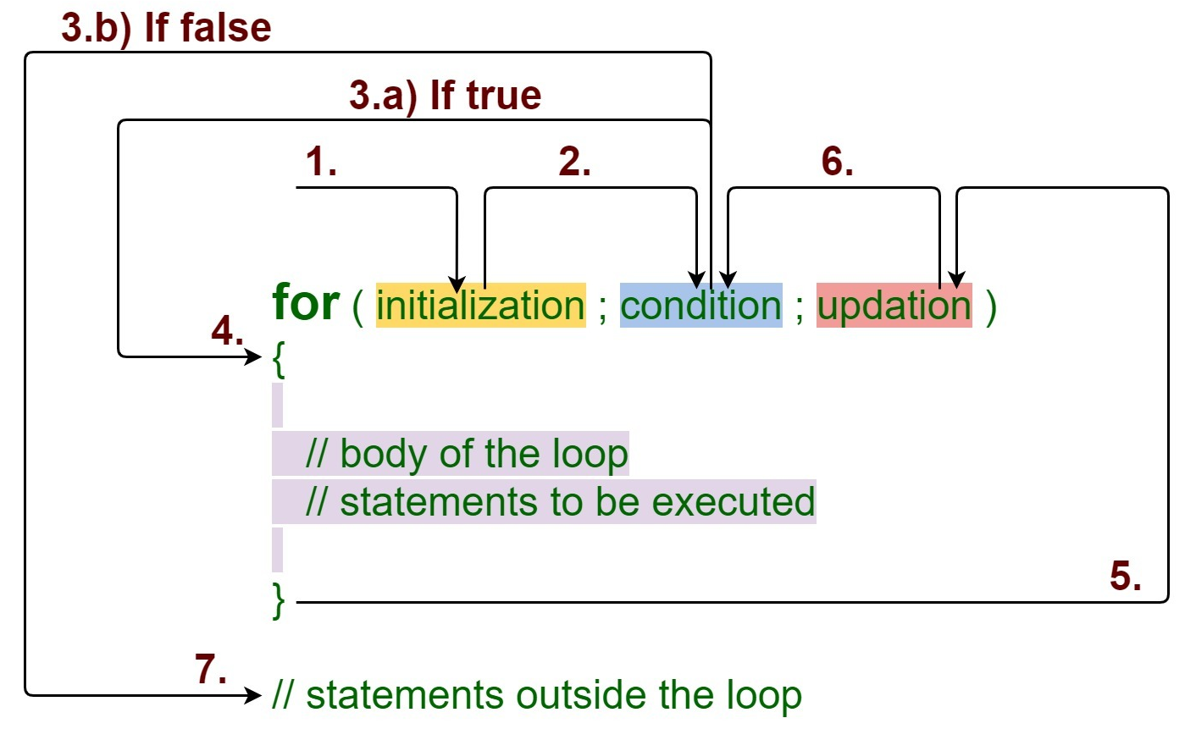
for Loop

Slide 40
Write a C++ program to calculate sum of first N natural numbers.
Output:
RUN 1:
Enter the value of N: 100
Sum is: 5050
RUN 2:
Enter the value of N: 10
Sum is: 55
RUn 3:
Enter the value of N: 3
Sum is: 6
LOGIC
read the value of N
Declare and initialize sum=0
Loop through sum=sum+1

Slide 41
Write a C++ program to calculate sum of first N natural numbers.
#include <iostream>
using namespace std;
int main() {
int n, i;
int sum;
cout << "Enter the value of N: ";
cin >> n;
sum = 0;
for (i = 1; i <= n; i++)
sum += i;
cout << "Sum is: " << sum << endl;
return 0;
}

Slide 42
Write a C++ Program To print Odd Numbers between 1 To n using for -loop
OUTPUT:
Enter how many number you want
10
Odd Numbers Between 1 to 10 :
1
3
5
7
9
Logic:
Read n
Declare and Initialize number=1
checking the condition number<=n
within the loop, to check whether number is EVEN or not
(number%2!=0)

Slide 43
//C++ Program To Print Odd Numbers Between 1 To N using “for”
#include <iostream>
using namespace std;
int main() {
int i, n;
cout << "Enter how many numbers you want: ";
cin >> n;
cout << "Odd Numbers Between 1 to " << n << ":\n";
for (i = 1; i <= n; i++) {
if (i % 2 != 0) {
cout << i << endl;
}
}
return 0;
}

Slide 44
Write a C Program to print Fibonacci series up to n using for loop
The sequence is a Fibonacci series is the sum of the previous two numbers.
The first two terms of the Fibonacci sequence is started from 0, 1.
In mathematical terms :F_{n} = F_{n-1} + F_{n-2} Where, F₀ : 0 F₁ : 1
Output:
Enter the number of elements:15
0 1 1 2 3 5 8 13 21 34 55 89 144 233 377

Slide 45
Write a C++ Program to print Fibonacci series up to n using for-loop
#include <iostream>
using namespace std;
int main() {
int n1 = 0, n2 = 1, n3, i, number;
cout << "Enter the number of elements: ";
cin >> number;
cout << endl << n1 << " " << n2; // printing 0 and 1
for (i = 2; i < number; ++i) // loop starts from 2 because 0 and 1 are already printed
{
n3 = n1 + n2;
cout << " " << n3;
n1 = n2;
n2 = n3;
}
return 0;
}

Slide 46
Write a C++ Program to Factorial of a given number using for -loop
Factorial of n is the product of all positive descending integers.
Factorial of n is denoted by n!.
For example:
5! = 5*4*3*2*1 = 120
3! = 3*2*1 = 6
Output:
Enter a number: 5
Factorial of 5 is: 120

Slide 47
Write a C++ Program to print Fibonacci series up to n using for-loop
#include <iostream>
int main() {
int i, fact = 1, number;
std::cout << "Enter a number: ";
std::cin >> number;
for (i = 1; i <= number; i++) {
fact = fact * i;
}
std::cout << "Factorial of " << number << " is: " << fact;
return 0;
}

Slide 48
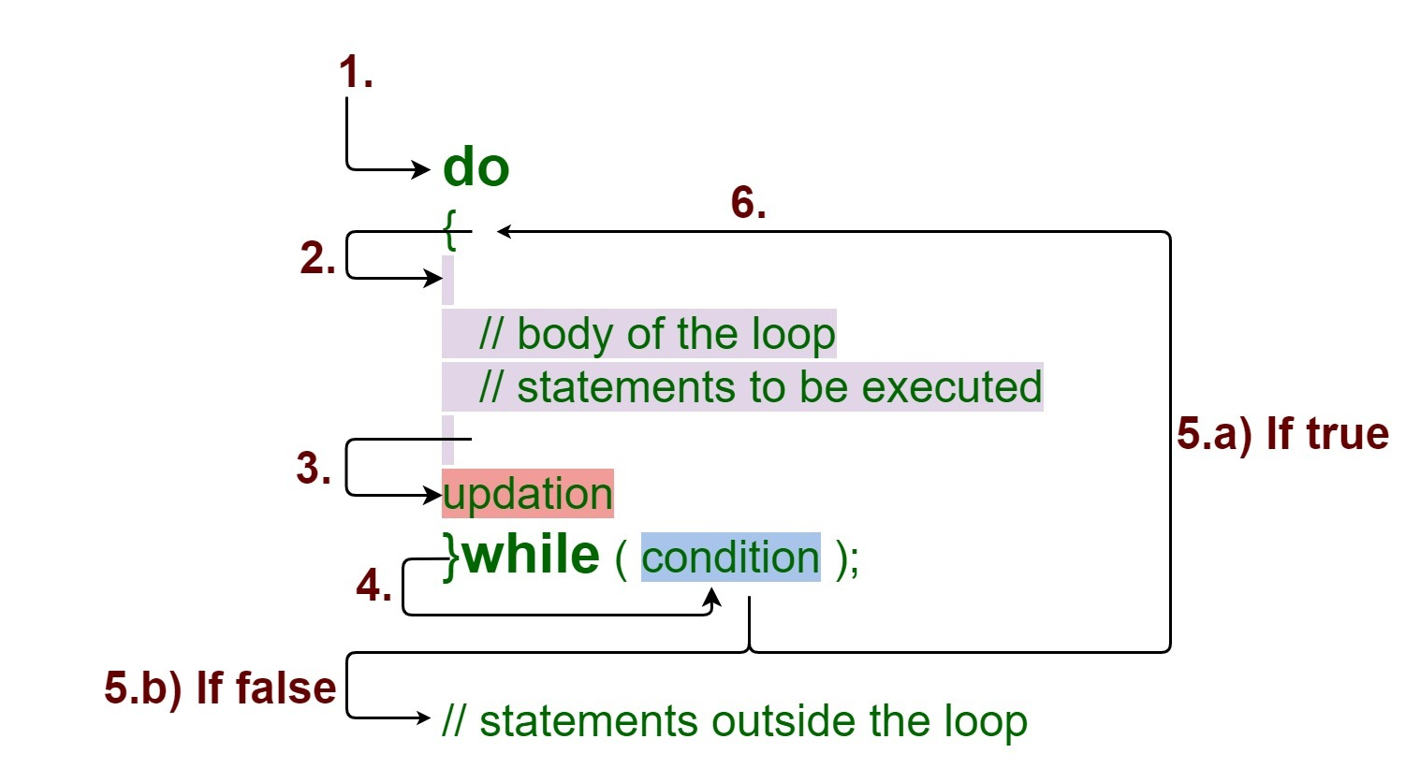
do-while Loop
The do while loop is a post tested loop.
The do-while loop is mainly used in the case where we need to execute the loop at least once before checking condition
syntax:
do{
//code to be executed
}while(condition)

Slide 49
do-while Loop
The do while loop is a post tested loop.
The do-while loop is mainly used in the case where we need to execute the loop at least once before checking condtion
syntax:
do{
//code to be executed
}while(condition)

Slide 50
do-while Loop
#include <iostream>
using namespace std;
int main() {
int j = 0;
do {
cout << "Value of variable j is: " << j << endl;
j++;
} while (j <= 3);
return 0;
}

Slide 51
Write a C++ Program to CALCULATOR App
Output
n1=5, n2=10 === Menu === 1. Addition 2. Substraction 3. Exit Enter your choice:1 The addition = 15
Notes:
We will see return in later lesson

Slide 52
#include <iostream>
using namespace std;
int main() {
int choice, n1 = 5, n2 = 10;
cout << "n1=5, n2=10" << endl;
do {
cout << "=== Menu ===" << endl;
cout << "1. Addition" << endl;
cout << "2. Subtraction" << endl;
cout << "3. Exit" << endl;
cout << "Enter your choice:";
cin >> choice;
switch (choice) {
case 1:
cout << "The addition = " << n1 + n2 << endl;
break;
case 2:
cout << "The subtraction = " << n1 - n2 << endl;
break;
case 3:
cout << "Goodbye" << endl;
break;
default:
cout << "Wrong Choice. Enter again" << endl;
break;
}
} while (choice != 3);
return 0;
}
Notes:
We will see return in later lesson

Slide 53
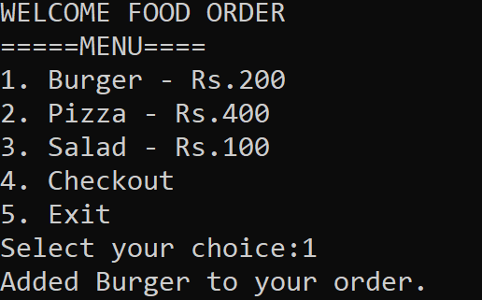
Write a C++ Program to display food ordering app using switch and do-while
Notes:
We will see return in later lesson

Slide 54
//FOOD ORDERING APP
#include <iostream>
using namespace std;
int main() {
int choice;
double total = 0.0;
do {
cout << "WELCOME FOOD ORDER"<< endl;
cout << "=====MENU====" << endl;
cout << "1. Burger - Rs.200" << endl;
cout << "2. Pizza - Rs.400" << endl;
cout << "3. Salad - Rs.100" << endl;
cout << "4. Checkout" << endl;
cout << "5. Exit" << endl;
cout << "Select your choice:";
cin >> choice;
switch (choice)
{
case 1:
total +=200.00;
cout << "Added Burger to your order." << endl;
break;
case 2:
total += 400.00;
cout << "Added Pizza to your order." << endl;
break;
case 3:
total += 100.00;
cout << "Added Salad to your order." << endl;
break;
case 4:
cout << "Your total order amount is: Rs." << total << endl;
break;
case 5:
cout << "Thank you for using the Food Ordering App! Goodbye!" << endl;
break;
default:
cout << "Invalid choice. Please select a valid option." << endl;
}
} while (choice != 5);
return 0;
}
Notes:
We will see return in later lesson

Slide 55
Q) Write a C++ program for NUMBER GUESSING GAME:
OUTPUT:
Welcome to the Number Guessing Game!
I have selected a number between 1 and 100. Try to guess it.
Enter your guess: 50
Too low! Try again.
Enter your guess: 75
Too high! Try again.
..
Enter your guess: 63
Congratulations! You've guessed the number in 3 attempts.

Slide 56
//NUMBER GUESSING GAME:
#include <iostream>
#include <cstdlib>
#include <ctime>
using namespace std;
int main() {
srand(time(0));
int secretNumber = rand() % 100 + 1;
int guess;
int attempts = 0;
cout << "Welcome to the Number Guessing Game!" << endl;
cout << "I have selected a number between 1 and 100. Try to guess it." << endl;
do {
cout << "Enter your guess: ";
cin >> guess;
attempts++;
if (guess < secretNumber)
{
cout << "Too low! Try again." << endl;
} else if (guess > secretNumber) {
cout << "Too high! Try again." << endl;
} else
{
cout << "Congratulations! You've guessed the number in " << attempts << " attempts." << endl;
}
} while (guess != secretNumber);
return 0;
}

Slide 57
Jump Statements/ Control with break and continue
Jump Statement makes the control jump to another section of the program unconditionally when encountered.
Used to terminate the loop or switch-case instantly.
Used to escape the execution of a section of the program.
Break
Continue
goto
Notes:
We will see return in later lesson

Slide 58
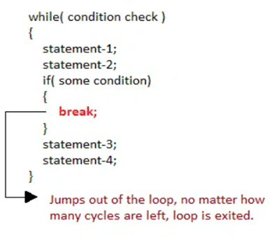
1) break Statement
A break statement is used to terminate the execution of the rest of the block where it is present and takes the control out of the block to the next statement.
To terminate the loop or switch block
Syntax:
break;
Notes:
As soon as the break statement is encountered from within a loop, the loop iterations stops there and control returns from the loop immediately to the first statement after the loop.

Slide 59
Q) Write a C++ program to break for loop when for 5th iteration of loop statement.
output:
0 1 2 3 4 5
came outside of loop i = 5
Notes:
As soon as the break statement is encountered from within a loop, the loop iterations stops there and control returns from the loop immediately to the first statement after the loop.

Slide 60
Write a C++ program to break for loop when for 5th iteration of loop statement.
#include <iostream>
int main() {
int i;
for (i = 0; i < 10; i++) {
std::cout << i << " ";
if (i == 5)
break;
}
std::cout << "came outside of loop i = " << i;
return 0;
}

Slide 61
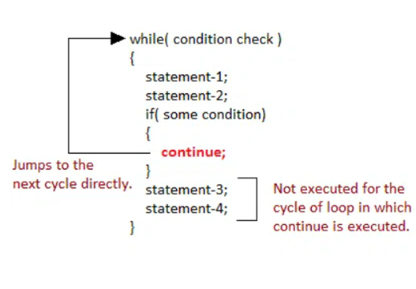
2. continue Statement
To execute the next iteration of the loop.
Syntax:
//loops stmts
continue;
//stmts to be skipped

Slide 62
Write a C++ program to continue for loop when for 5th iteration of loop statement.
#include <iostream>
int main() {
int i = 1; // initializing a local variable
// starting a loop from 1 to 10
for (i = 1; i <= 10; i++) {
if (i == 5) { // if value of i is equal to 5, it will continue for next iteration
continue;
}
std::cout << i << std::endl;
} // end of for loop
return 0;
}

Slide 63
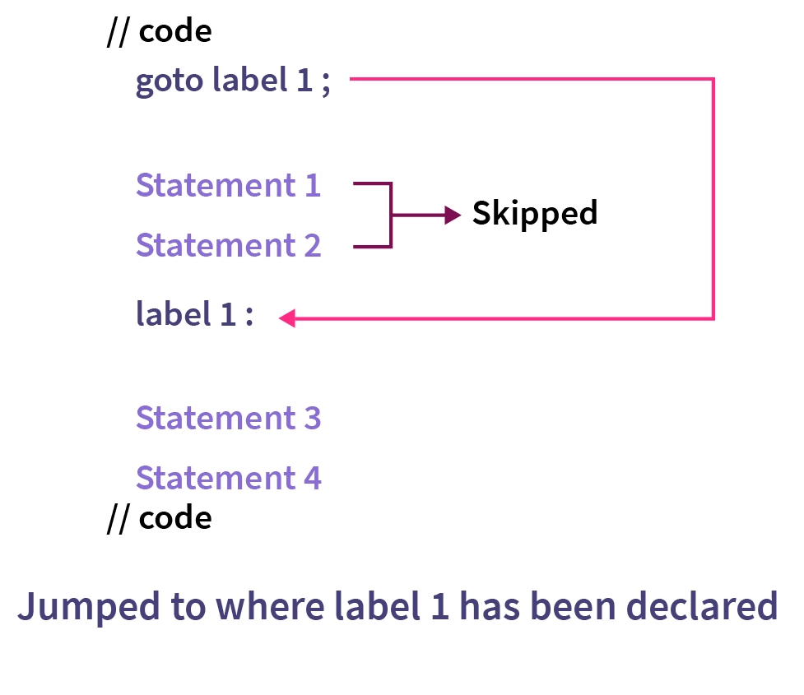
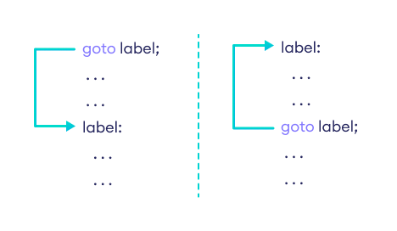
3) goto statement
It is used to transfer control to the other part of the program. It unconditionally jumps to the specified label.

Slide 64
Q) Write a C++ program that counts and prints the numbers from 1 to 10, excluding the number 5. Use the goto statement to achieve this.
Provide the C++ code along with an explanation of how the goto statement is used to control the flow of the loop.
#include <iostream>
int main() {
int i = 1; // initializing a local variable
loop_start:
if (i <= 10) {
if (i == 5) {
i++;
goto loop_start; // Jump to loop_start label
}
std::cout << i << std::endl;
i++;
goto loop_start; // Jump to loop_start label
}
return 0;
}

